Slide 1

Chapter 6 Queries and Interfaces
SEG301m

Slide 2
Objectives
What are information needs and queries?
What is query transformation?
How to show the results?

Slide 3
Contents
6.1 Information needs and queries
6.2 Query Transformation and refinement: stopping and stemming revisited, spell checking and suggestions, query expansion, relevance feedback, context and personalization
6.3 Showing the results: result pages and snippets, advertising and search, clustering the results
6.4 Cross-language search

Slide 4
6.1 Information needs and queries
The number of relevant documents being sought
The tasks that led to the requirement for information
Queries can represent very different information needs and may require different search techniques and ranking algorithms to produce the best rankings.
A query can be a poor representation of the information need.

Slide 5
6.2 Query transformation and refinement: Stopping and Stemming revisited
Stopword removal can be done at query time instead of during document indexing. Stopwords can be treated as:
Normal words
Removed, or removed except under certain conditions
Query-based stemming is another technique for increasing the ﬂexibility of the search engine
Bad case: The query “fish village” will produce very different results from the query “fishing village”, but many stemming algorithms would reduce “fishing” to “fish” → using the appropriate word variants, instead of word to a word stem

Slide 6



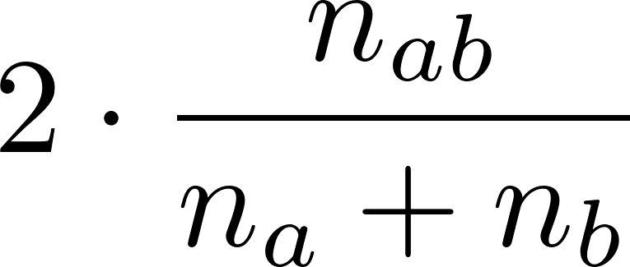
6.2 Query transformation and refinement: Stopping and Stemming revisited
Term association measure : Dice’s coefficient
is the number of windows (or documents) containing word a, is the number of windows containing word b, is the number of windows containing both words a and b, and N is the number of text windows in the collection, then Dice’s coefficient is

Slide 7
6.2 Query transformation and refinement: Spell Checking and Suggestions
Spell checking is an extremely important part of query processing?
Basic approach used in many spelling checkers: spelling dictionary
“Word” Not found? → similarity measure: edit distance
extenssions → extensions (insertion error): edit distance 2
poiner → pointer (deletion error)
marshmellow → marshmallow (substitution error)
brimingham → birmingham (transposition error)

Slide 8
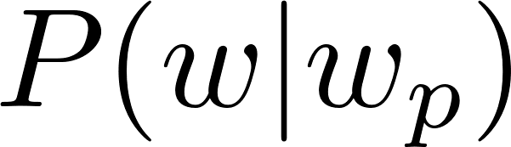
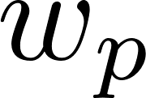

6.2 Query transformation and refinement: Spell Checking and Suggestions
Noisy channel model: a person chooses a word w, probability distribution P(w). noisy channel causes the person to write the word e instead with probability P(e|w). Probabilities P(w), called the language model. rank the corrections → P(e|w)P(w)
Context?
where the probability of a word w following the previous word , is a parameter that specifies the relative importance of the two probabilities

Slide 9
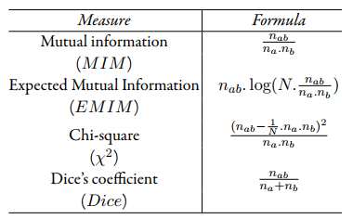
6.2 Query transformation and refinement: Query expansion
Term association measures

Slide 10
6.2 Query transformation and refinement: Context and Personalization
The results of a query will be the same regardless of
Who submitted the query,
Why the query was submitted,
Where the query was submitted,
What other queries were submitted in the same session
Context: affects the relevance of retrieved documents and could potentially have a signifcant impact on the ranking algorithm
Difficult to capture and represent
→ learning user models → personalized: problems?
Notes:
the accuracy of the user models
create the profles based on the documents that the person looks at, such as web pages visited, email messages → privacy

Slide 11
6.2 Query transformation and refinement: Context and Personalization
The most useful contextual information for improving search quality is based on past interactions with the search engine
Local search based on geographic context can also produce substantial improvements, including 3 main steps:
Identify the geographic region associated with web pages, using location metadata that has been manually added to the document, or by automatically identifying locations, such as place names, city names, or country names, in the document text.
Identify the geographic region associated with the query using automatic techniques.
Rank web pages using a comparison of the query and document location information in addition to the usual text- and link-based features
Notes:
Analysis of query logs has shown that 10–15% of queries contain some location reference.

Slide 12

6.3 Showing the results: Result page and Snippets
Successful interactions with a search engine depend on the user understanding the results.
Visualization techniques
Document summaries: title, URL, links to live, cached versions of the page, a short text summary (snippet)
Need: text summarization techniques!
Notes:
Successful interactions with a search engine depend on the user understanding the results.
Typical document summary for a web search

Slide 13
6.3 Showing the results: Result page and Snippets
Luhn’s algorithm?

Slide 14
6.3 Showing the results: Advertising and Search
Advertising is a key component of web search engines?
That is how companies generate revenue
Goal?
Find advertisements that are appropriate for the query context
Advertisers bid for keywords that describe topics associated with their product
The key issues:
Techniques for matching short pieces of text (the query and the advertisement)
Selecting keywords to represent the content of web pages
Notes:
- The amount bid for a keyword that matches a query is an important factor in determining which advertisement is selected
- some advertisements generatemore clickthrough because they are more appealing to the user population

Slide 15

6.3 Showing the results: Advertising and Search
The list of advertisements generated by a search engine for the query “fish tanks”
Two of the advertisements are obvious matches, in that “fish tanks” occurs in the titles
Two of the others have no words in common with the query, although they are clearly relevant
Third advertisement is similar and matches one of the query words

Slide 16
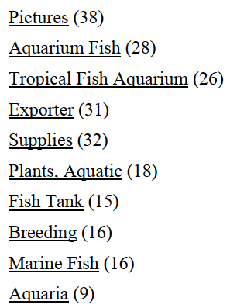
6.3 Showing the results: Clustering the results
Clustering groups documents?
Similar in content and labels → quickly scanned for relevance.
Clusters formed by a search engine from top-ranked documents for the query “tropical fish”. Numbers in brackets are the number of documents in the cluster.

Slide 17
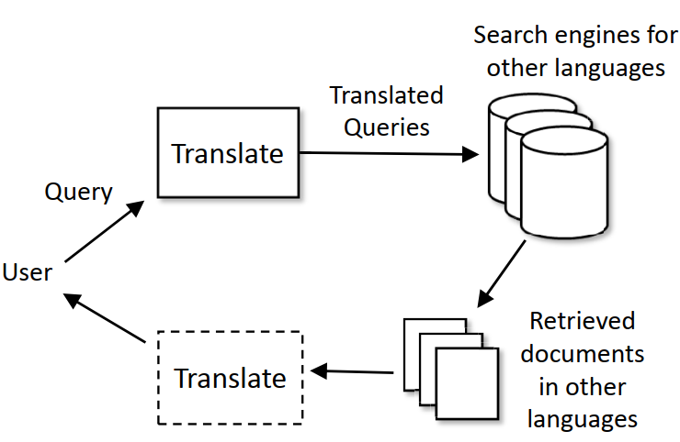
6.4 Cross-Language Search
Translating queries for one or more monolingual search engines covering different languages
Use a large bilingual dictionary
Statistical machine translation models

Slide 18
Exercise
Using the Wikipedia collection
Index the collection without stemming.
Identify the frst 1,000 words (in alphabetical order) in the index
Create stem classes by stemming these 1,000 words and recording which words become the same stem
Compute association measures (Dice’s coefficient) between all pairs of stems in each stem class

Slide 19
Summary
Information needs and queries
Query Transformation and refinement
Show the results
Cross-language search

